Slide 1
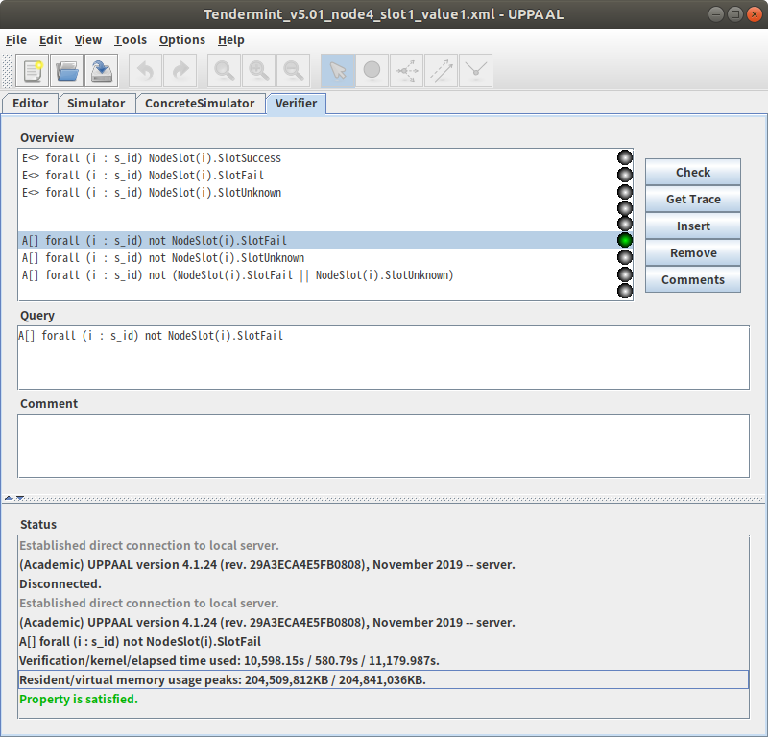
Tendermint_v5.01_node4_slot1_value1
(Breadth first/Aggressive/CompactDataStructure option)
Verification for Prop4.
A[] forall (i : s_id) not NodeSlot(i).SlotFail
Verification/kernel/elapsed time used: 10,598.15s / 580.79s / 11,179.987s.
Resident/virtual memory usage peaks: 204,509,812KB / 204,841,036KB.
1
Notes:
<숫자>

Slide 2
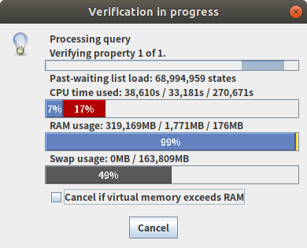
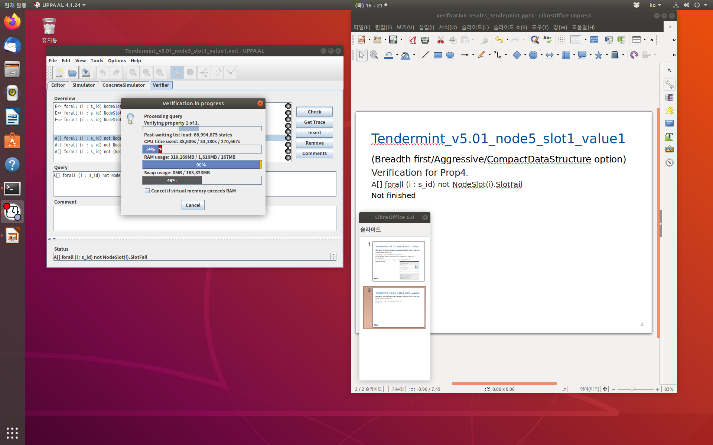
Tendermint_v5.01_node5_slot1_value1
(Breadth first/Aggressive/CompactDataStructure option)
Verification for Prop4.
A[] forall (i : s_id) not NodeSlot(i).SlotFail
Not finished
1
Notes:
<숫자>

Slide 3
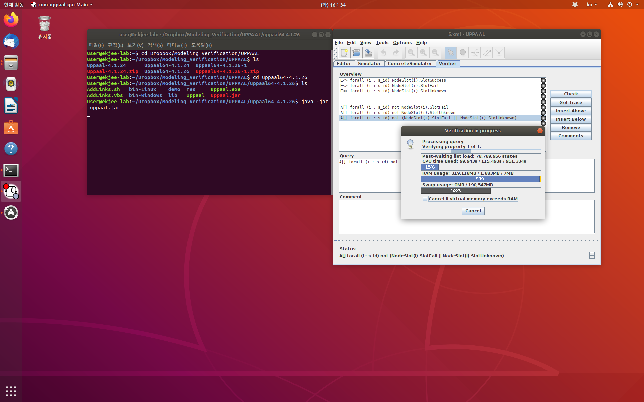
5.xml
(Breadth first/Aggressive/CompactDataStructure option)
Verification for Prop6.
A[] forall (i : s_id) not (NodeSlot(i).SlotFail ||NodeSlot(i).SlotUnknown)Not finished
Not finished
1
Notes:
<숫자>

Slide 4
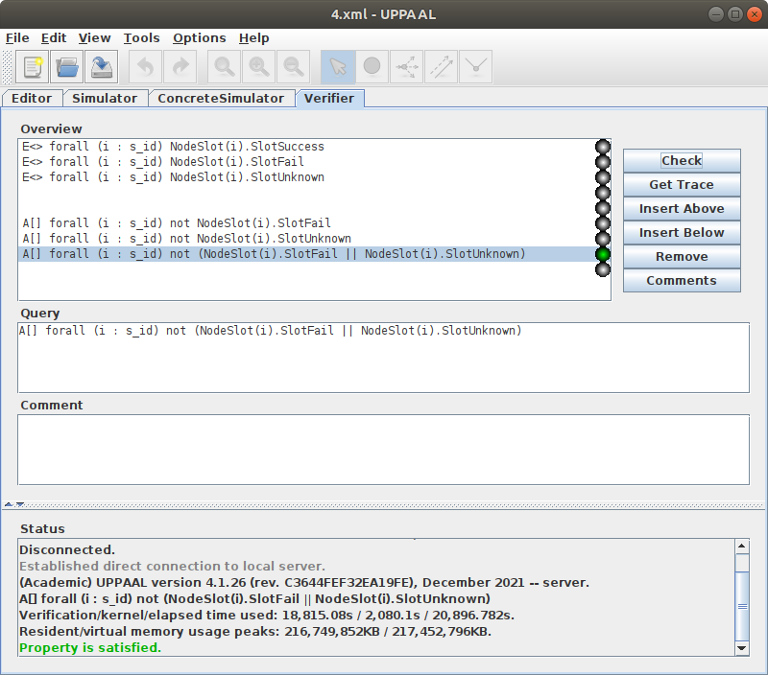
4.xml
(Breadth first/Aggressive/CompactDataStructure option)
Verification for Prop6.
A[] forall (i : s_id) not (NodeSlot(i).SlotFail ||NodeSlot(i).SlotUnknown)Not finished
Verification/kernel/elapsed time used: 18,815.08s / 2,080.1s / 20,896.782s
Resident/virtual memory usage peaks:
216,749,852KB / 217,452,796KB
1
Notes:
<숫자>

Slide 5
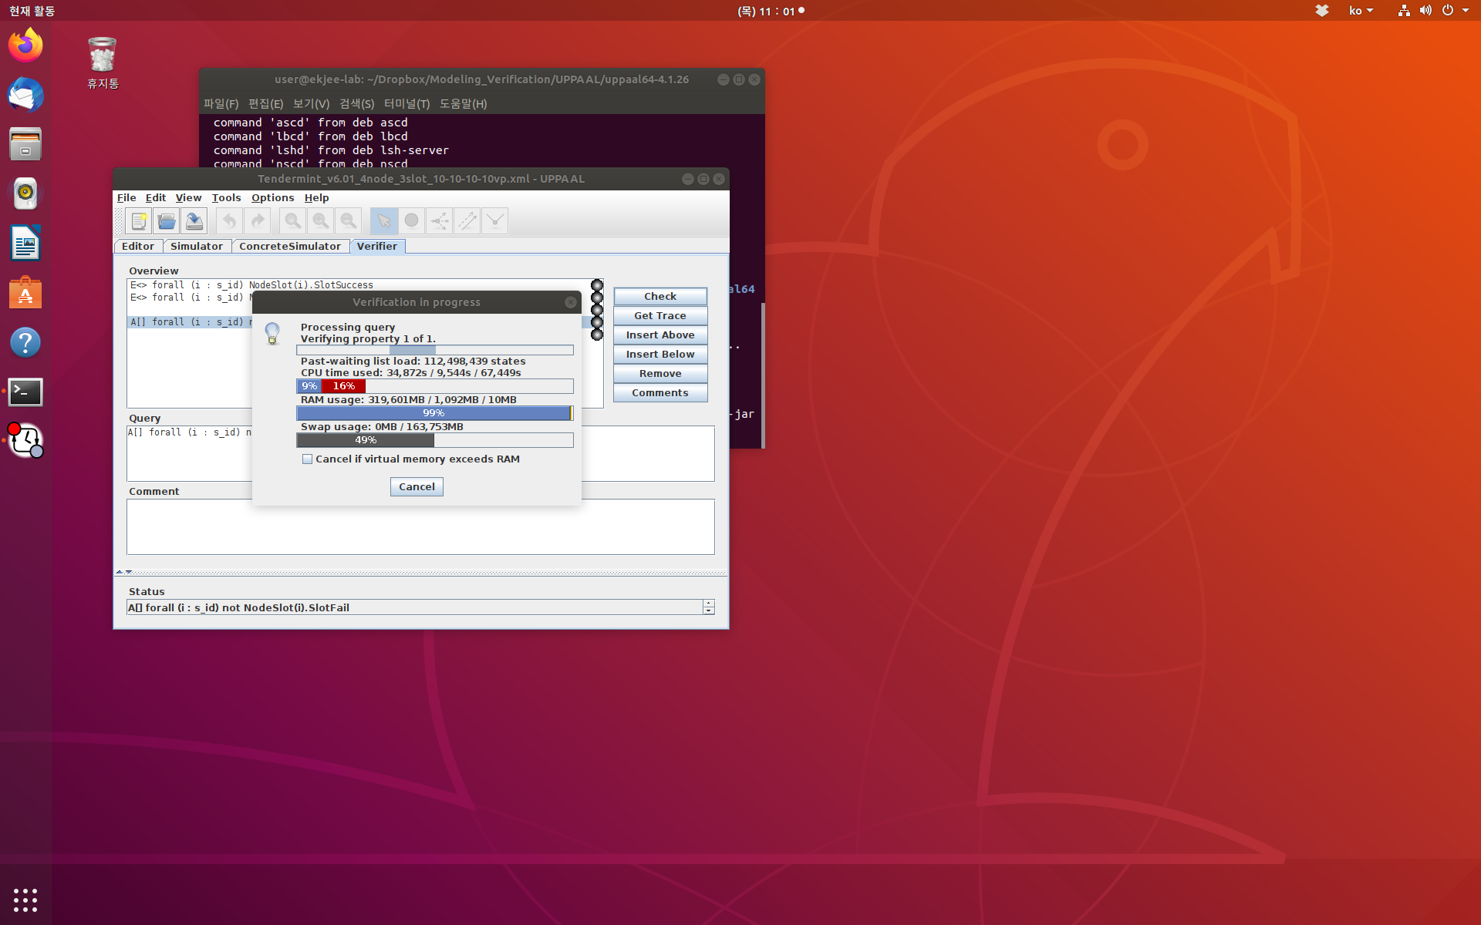
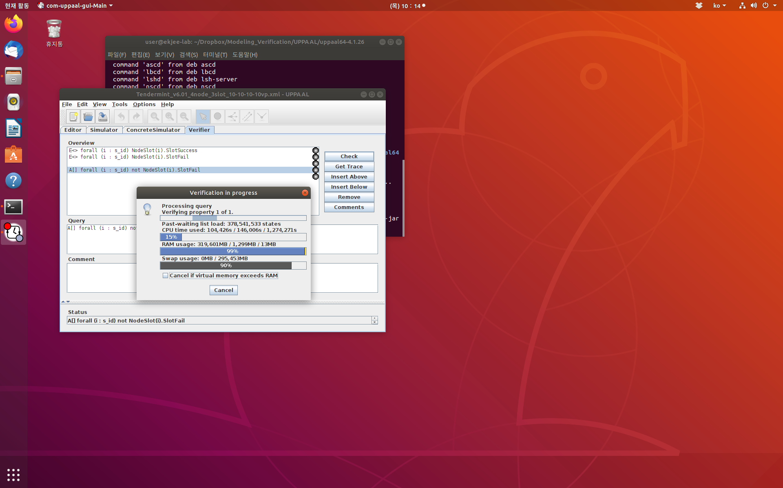
Tendermint_v6.01_4node_3slot_10-10-10vp.xml.xml
(Breadth first/Aggressive/CompactDataStructure option)
Verification for Prop6.
A[] forall (i : s_id) not NodeSlot(i).SlotFail
Verification/kernel/elapsed time used:
Resident/virtual memory usage peaks:
1
Notes:
<숫자>

Slide 6
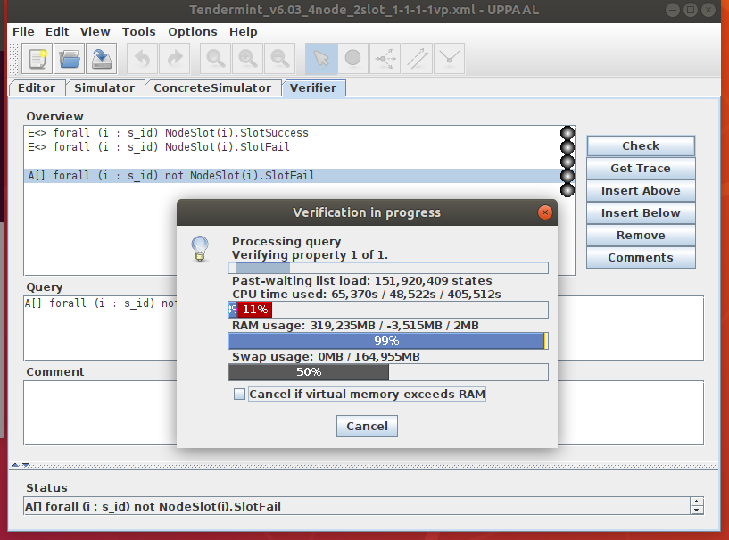
Tendermint_v6.03_4node_2slot_1-1-1-1vp.xml
(Breadth first/Aggressive/CompactDataStructure option)
Verification for Prop6.
A[] forall (i : s_id) not NodeSlot(i).SlotFail
Verification/kernel/elapsed time used:
Resident/virtual memory usage peaks:
1
Notes:
<숫자>

Slide 7
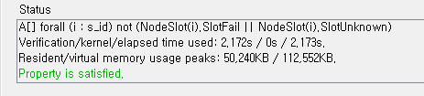
Tendermint_v7.01_5node_3slot_1-1-1-1vp.xml
(Breadth first/Aggressive/CompactDataStructure option)
Open membership:5-3-4
A[] forall (i : s_id) not (NodeSlot(i).SlotFail || NodeSlot(i).SlotUnknown)
Verification/kernel/elapsed time used: 2.172s / 0s / 2.173s.
Resident/virtual memory usage peaks: 50,240KB / 112,552KB.

Slide 8
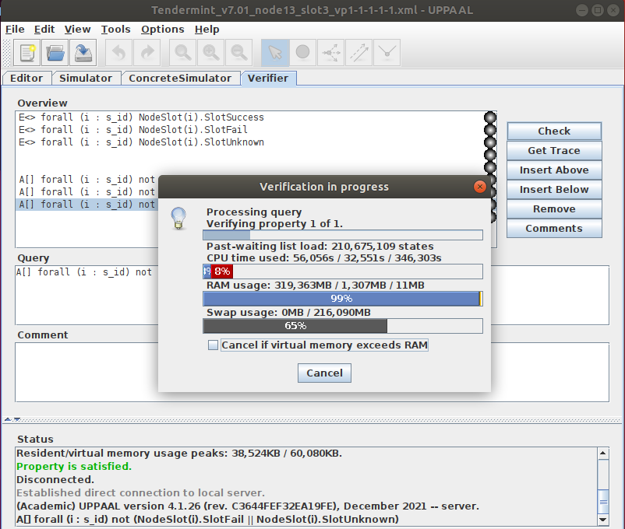
Tendermint_v7.01_node13_slot3_vp1-1-1-1.xml
(Breadth first/Aggressive/CompactDataStructure option)

Slide 9
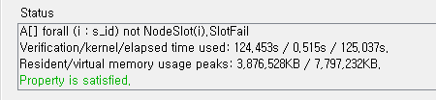
Tendermint_v7.03_node5_slot3_vp1.xml
(Breadth first/Aggressive/CompactDataStructure option)

Slide 10
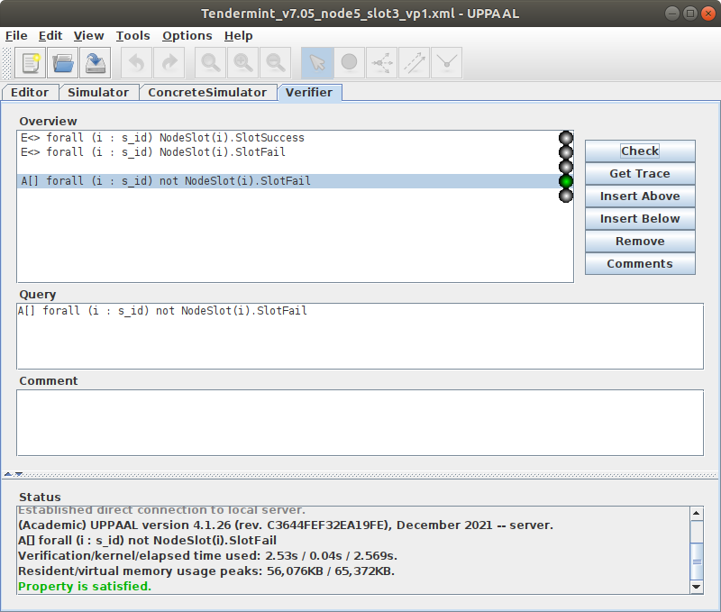
Tendermint_v7.05_node5_slot3_vp1.xml
(Breadth first/Aggressive/CompactDataStructure option)

Slide 11
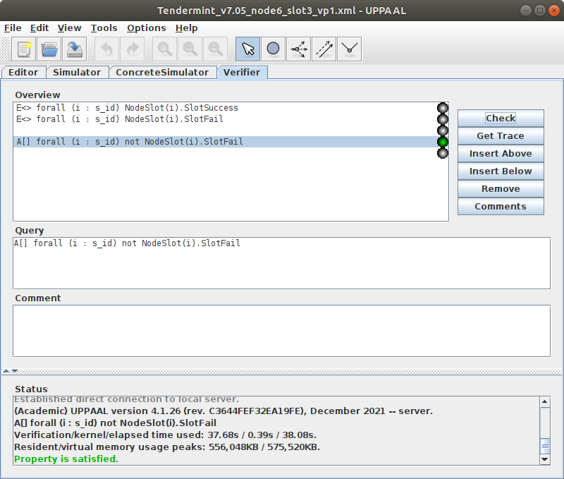
Tendermint_v7.05_node6_slot3_vp1.xml
(Breadth first/Aggressive/CompactDataStructure option)

Slide 12
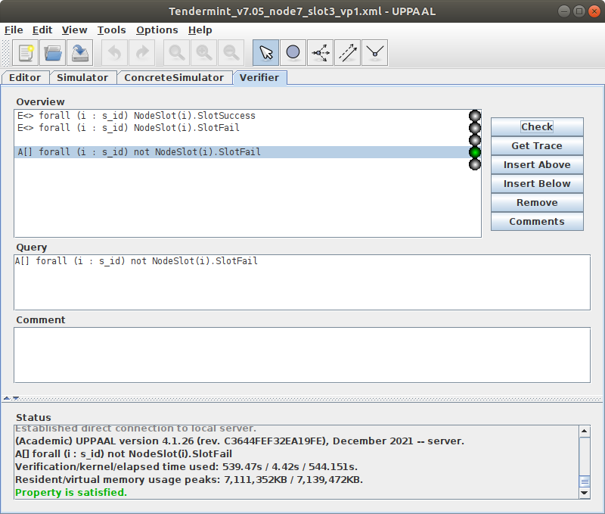
Tendermint_v7.05_node7_slot3_vp1.xml
(Breadth first/Aggressive/CompactDataStructure option)

Slide 13

Tendermint_v7.05_node8_slot3_vp1.xml
(Breadth first/Aggressive/CompactDataStructure option)

Slide 14
v7.07

Slide 15
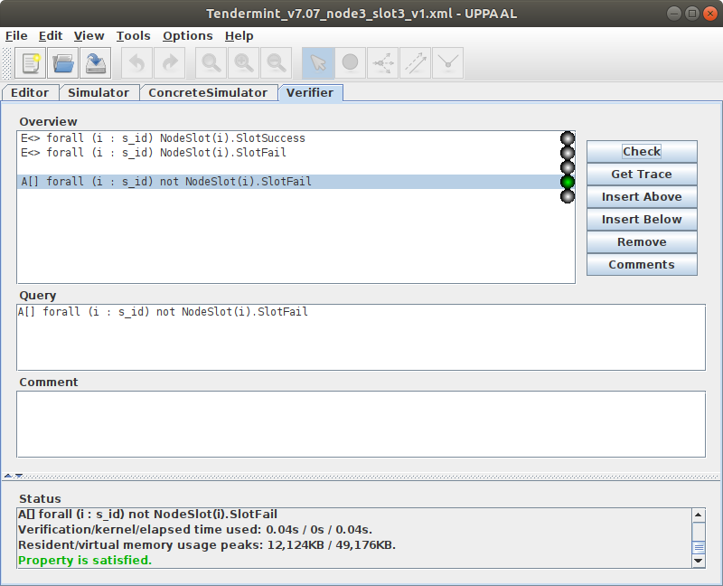
Tendermint_v7.07_node3_slot3_v1.xml
(Breadth first/Aggressive/CompactDataStructure option)
A[] forall (i : s_id) not NodeSlot(i).SlotFail
Verification/kernel/elapsed time used: 0.04s / 0s / 0.04s.
Resident/virtual memory usage peaks: 12,124KB / 49,176KB.
Property is satisfied.

Slide 16
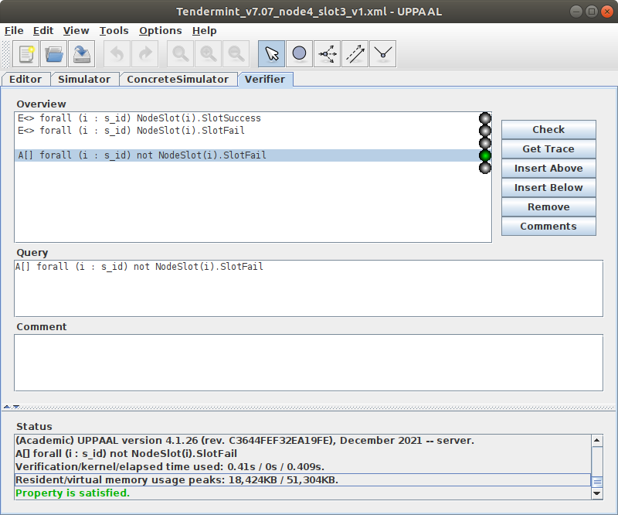
Tendermint_v7.07_node4_slot3_v1.xml
(Breadth first/Aggressive/CompactDataStructure option)
A[] forall (i : s_id) not NodeSlot(i).SlotFail
Verification/kernel/elapsed time used: 0.41s / 0s / 0.409s.
Resident/virtual memory usage peaks: 18,424KB / 51,304KB.
Property is satisfied.

Slide 17

Tendermint_v7.07_node5_slot3_v1.xml
(Breadth first/Aggressive/CompactDataStructure option)
A[] forall (i : s_id) not NodeSlot(i).SlotFail
Verification/kernel/elapsed time used: 5.38s / 0.06s / 5.446s.
Resident/virtual memory usage peaks: 103,220KB / 108,936KB.
Property is satisfied.

Slide 18
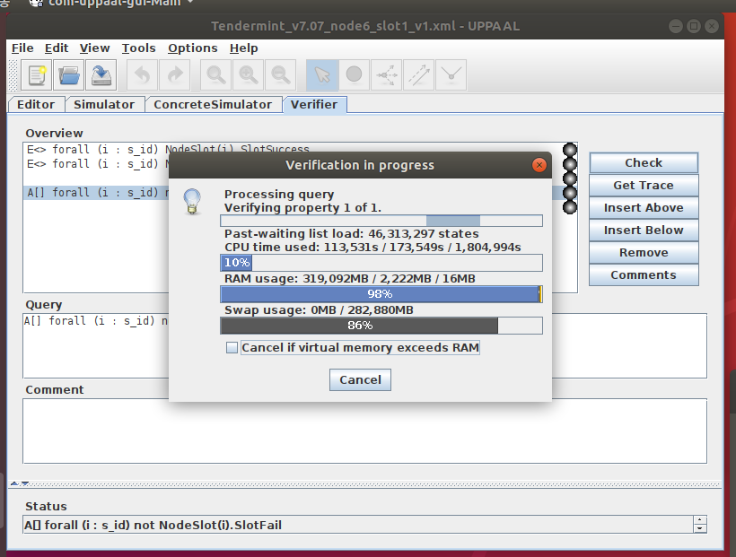
Tendermint_v7.07_node6_slot3_v1.xml
(Breadth first/Aggressive/CompactDataStructure option)
A[] forall (i : s_id) not NodeSlot(i).SlotFail
Unfinished...

Slide 19
v7.08

Slide 20
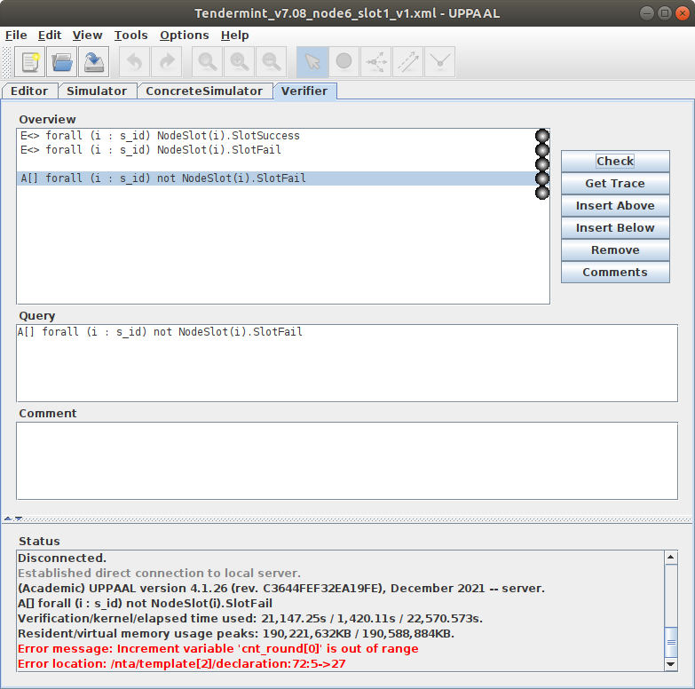
Tendermint_v7.08_node6_slot1_v1.xml
(Breadth first/Aggressive/CompactDataStructure option)
A[] forall (i : s_id) not NodeSlot(i).SlotFail
Verification/kernel/elapsed time used: 21,147.25s / 1,420.11s / 22,570.573s.
Resident/virtual memory usage peaks: 190,221,632KB / 190,588,884KB.

Slide 21
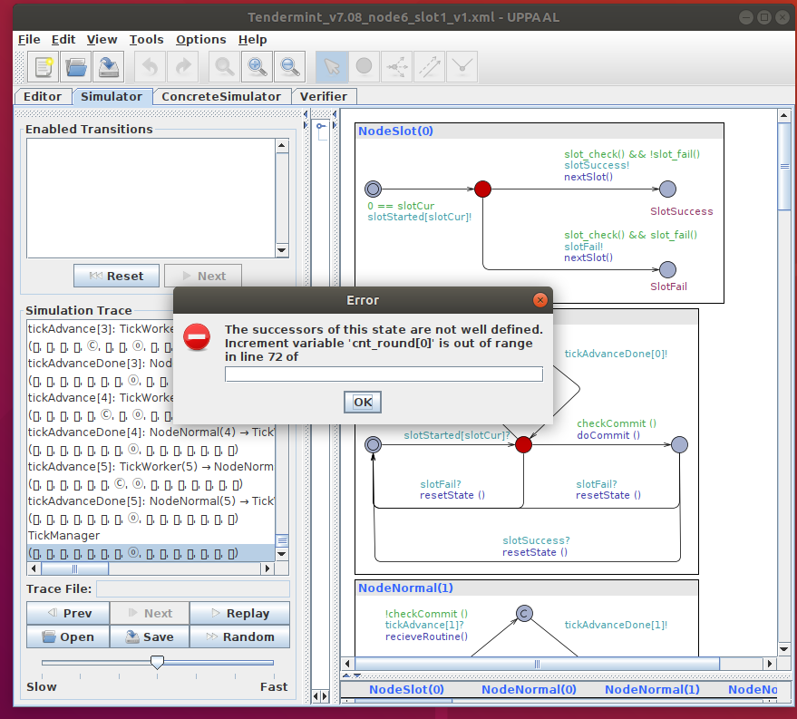
Tendermint_v7.08_node6_slot1_v1.xml

Slide 22
v7.09

Slide 23
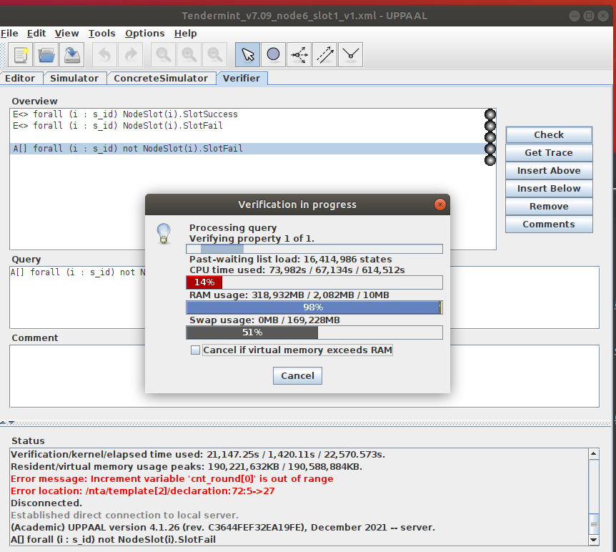
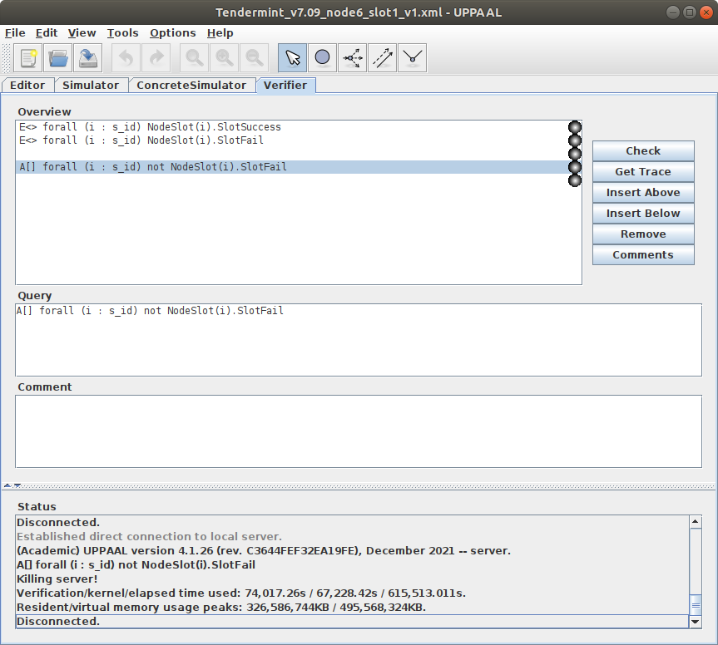
Tendermint_v7.09_node6_slot1_v1.xml
(Breadth first/Aggressive/CompactDataStructure option)
A[] forall (i : s_id) not NodeSlot(i).SlotFail
=> Not finished
Killing server!
Verification/kernel/elapsed time used: 74,017.26s / 67,228.42s / 615,513.011s.
Resident/virtual memory usage peaks: 326,586,744KB / 495,568,324KB.
Disconnected.

Slide 24
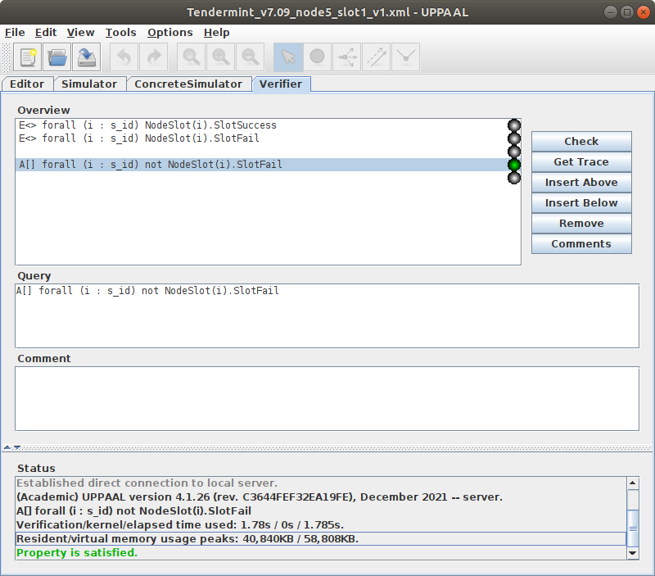
Tendermint_v7.09_node5_slot1_v1.xml
(Breadth first/Aggressive/CompactDataStructure option)
A[] forall (i : s_id) not NodeSlot(i).SlotFail
Verification/kernel/elapsed time used: 1.78s / 0s / 1.785s.
Resident/virtual memory usage peaks: 40,840KB / 58,808KB.

Slide 25
v7.11

Slide 26
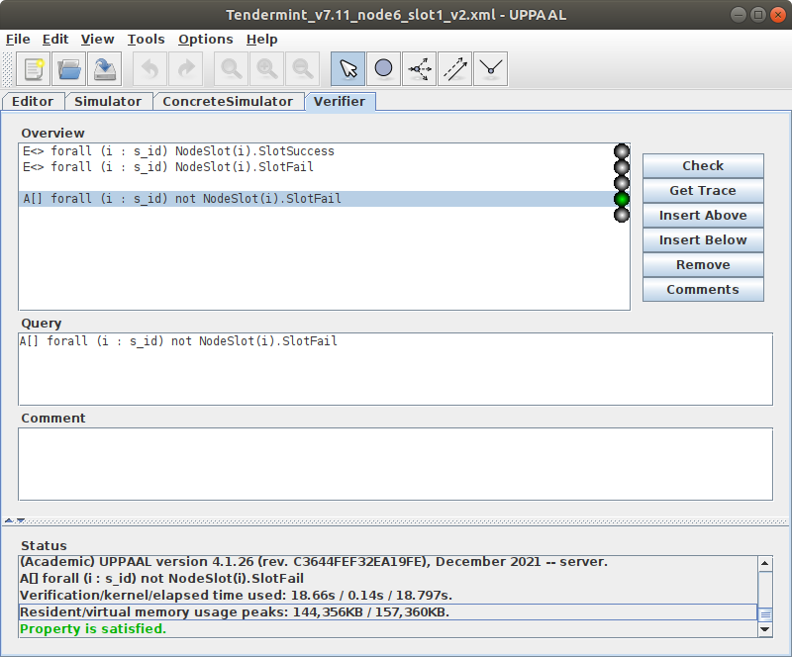
Tendermint_v7.11_node6_slot1_v2.xml
(Breadth first/Aggressive/CompactDataStructure option)
A[] forall (i : s_id) not NodeSlot(i).SlotFail
Verification/kernel/elapsed time used: 18.66s / 0.14s / 18.797s.
Resident/virtual memory usage peaks: 144,356KB / 157,360KB.

Slide 27
V7.13 – scalability

Slide 28
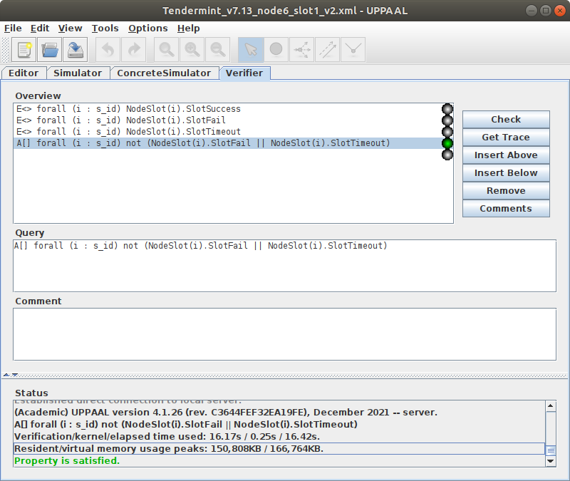
Tendermint_v7.13_node6_slot1_v2.xml
(Breadth first/Aggressive/CompactDataStructure option)
A[] forall (i : s_id) not (NodeSlot(i).SlotFail || NodeSlot(i).SlotTimeout)
Property is satisfied.
Verification/kernel/elapsed time used: 16.17s / 0.25s / 16.42s.
Resident/virtual memory usage peaks: 150,808KB / 166,764KB.

Slide 29
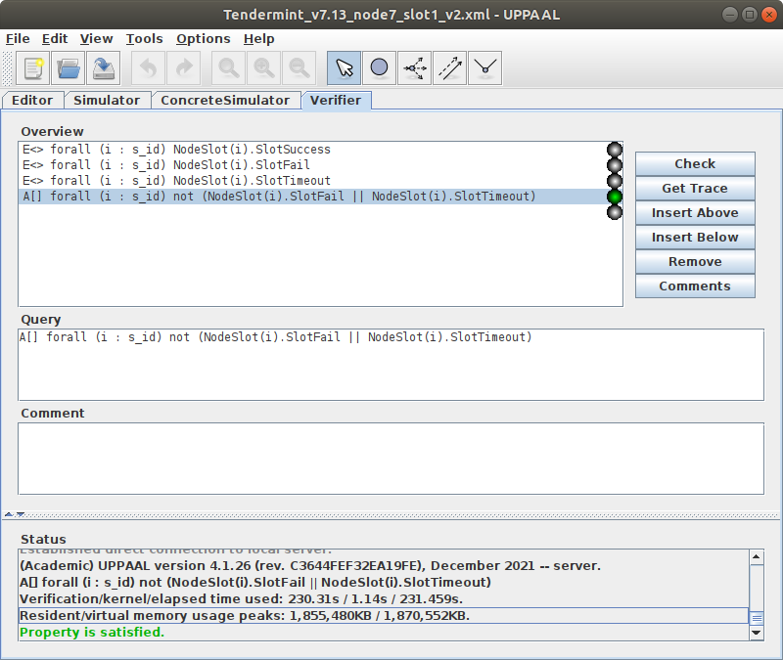
Tendermint_v7.13_node7_slot1_v2.xml
(Breadth first/Aggressive/CompactDataStructure option)
A[] forall (i : s_id) not (NodeSlot(i).SlotFail || NodeSlot(i).SlotTimeout)
Property is satisfied.
Verification/kernel/elapsed time used: 230.31s / 1.14s / 231.459s.
Resident/virtual memory usage peaks: 1,855,480KB / 1,870,552KB.

Slide 30

Tendermint_v7.13_node8_slot1_v2.xml
(Breadth first/Aggressive/CompactDataStructure option)
A[] forall (i : s_id) not (NodeSlot(i).SlotFail || NodeSlot(i).SlotTimeout)
Property is satisfied.
Verification/kernel/elapsed time used: 2,699.53s / 28.23s / 2,727.924s.
Resident/virtual memory usage peaks: 27,287,376KB / 27,337,172KB.

Slide 31

Tendermint_v7.13_node9_slot1_v2.xml
(Breadth first/Aggressive/CompactDataStructure option)
A[] forall (i : s_id) not (NodeSlot(i).SlotFail || NodeSlot(i).SlotTimeout)
Property is satisfied.
Verification/kernel/elapsed time used: 32,670.69s / 3,142.58s / 35,816.155s.
Resident/virtual memory usage peaks: 283,193,796KB / 283,361,008KB.

Slide 32
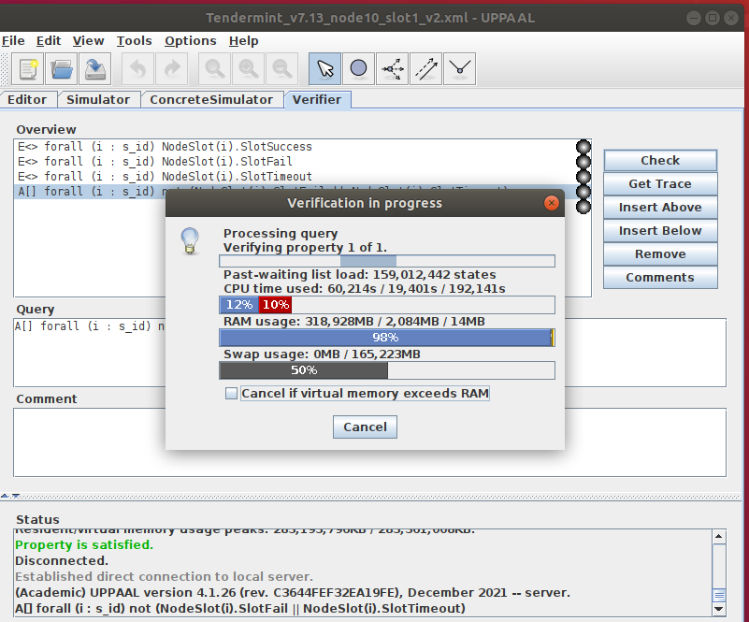
Tendermint_v7.13_node10_slot1_v2.xml
(Breadth first/Aggressive/CompactDataStructure option)
A[] forall (i : s_id) not (NodeSlot(i).SlotFail || NodeSlot(i).SlotTimeout)
Not finished

Slide 33
V7.13 – open membership

Slide 34
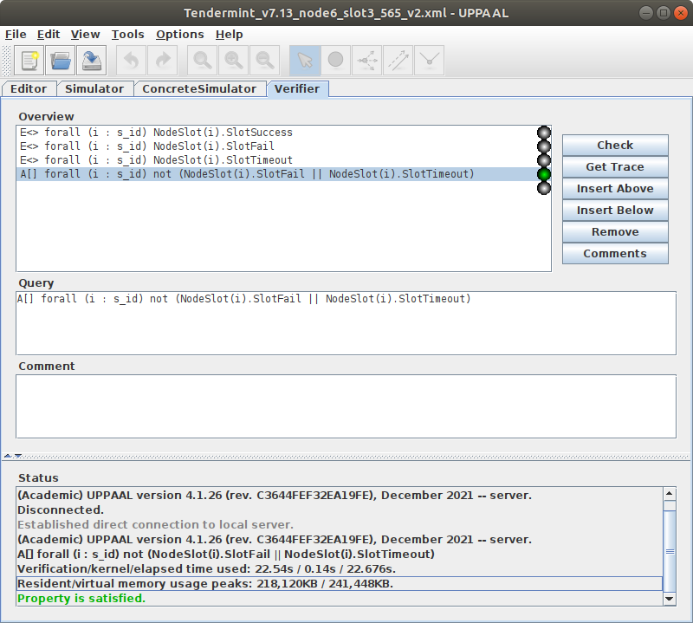
Tendermint_v7.13_node6_slot3_565_v2.xml
(Breadth first/Aggressive/CompactDataStructure option)
A[] forall (i : s_id) not (NodeSlot(i).SlotFail || NodeSlot(i).SlotTimeout)
Property is satisfied.
Verification/kernel/elapsed time used: 22.54s / 0.14s / 22.676s.
Resident/virtual memory usage peaks: 218,120KB / 241,448KB.

Slide 35
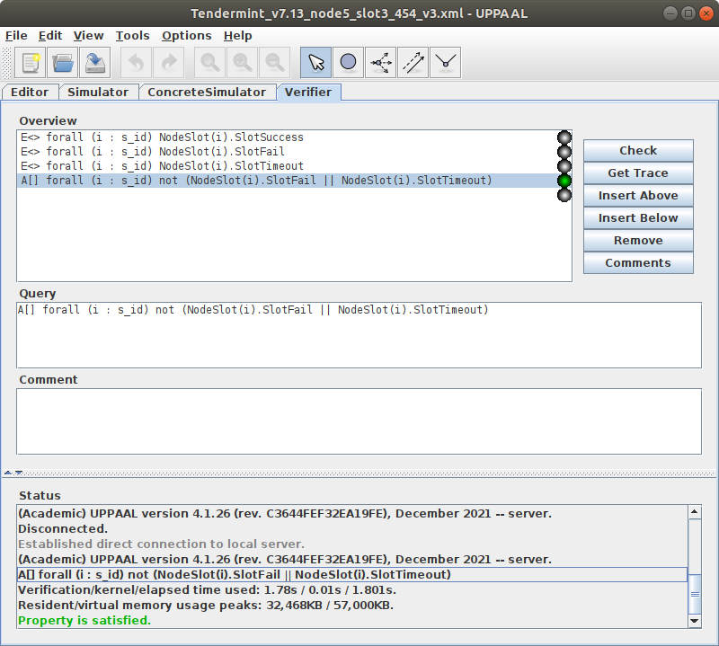
Tendermint_v7.13_node5_slot3_454_v3.xml
(Breadth first/Aggressive/CompactDataStructure option)
A[] forall (i : s_id) not (NodeSlot(i).SlotFail || NodeSlot(i).SlotTimeout)
Property is satisfied.
Verification/kernel/elapsed time used: 1.78s / 0.01s / 1.801s.
Resident/virtual memory usage peaks: 32,468KB / 57,000KB.

Slide 36
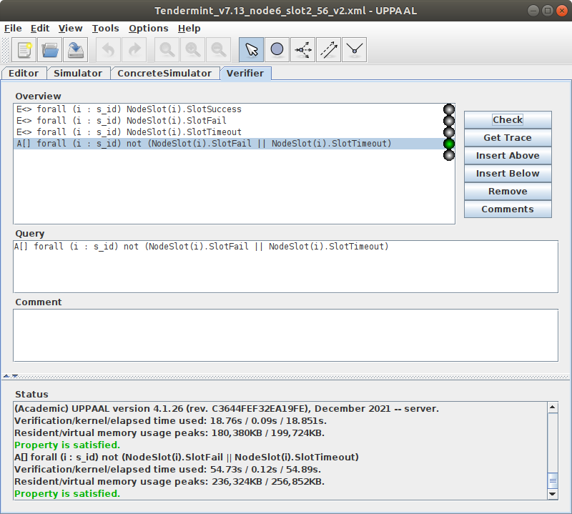
Tendermint_v7.13_node5_slot2_56_v2.xml
(Breadth first/Aggressive/CompactDataStructure option)
A[] forall (i : s_id) not (NodeSlot(i).SlotFail || NodeSlot(i).SlotTimeout)
Property is satisfied.
Verification/kernel/elapsed time used: 54.73s / 0.12s / 54.89s.
Resident/virtual memory usage peaks: 236,324KB / 256,852KB.

Slide 37
v7.15 – open membership

Slide 38
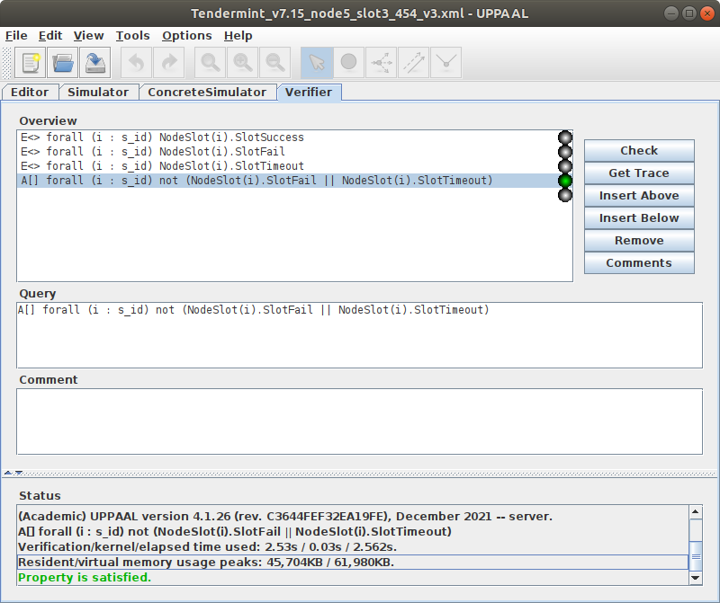
Tendermint_v7.15_node5_slot3_454_v3.xml
(Breadth first/Aggressive/CompactDataStructure option)
A[] forall (i : s_id) not (NodeSlot(i).SlotFail || NodeSlot(i).SlotTimeout)
Property is satisfied.
Verification/kernel/elapsed time used: 2.53s / 0.03s / 2.562s.
Resident/virtual memory usage peaks: 45,704KB / 61,980KB.

Slide 39

Tendermint_v7.15_node6_slot2_56_v2.xml
(Breadth first/Aggressive/CompactDataStructure option)
A[] forall (i : s_id) not (NodeSlot(i).SlotFail || NodeSlot(i).SlotTimeout)
Property is satisfied.
Verification/kernel/elapsed time used: 29.8s / 0.15s / 29.953s.
Resident/virtual memory usage peaks: 328,604KB / 341,076KB.

Slide 40
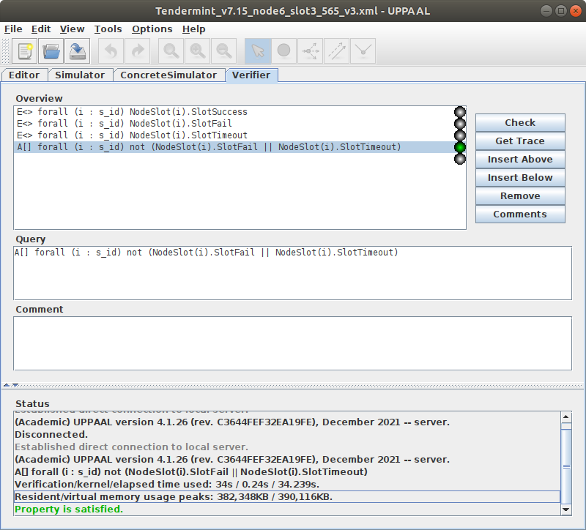
Tendermint_v7.15_node6_slot3_565_v3.xml
(Breadth first/Aggressive/CompactDataStructure option)
A[] forall (i : s_id) not (NodeSlot(i).SlotFail || NodeSlot(i).SlotTimeout)
Property is satisfied.
Verification/kernel/elapsed time used: 34s / 0.24s / 34.239s.
Resident/virtual memory usage peaks: 382,348KB / 390,116KB.

Slide 41

Tendermint_v7.15_node7_slot2_67_v2.xml
(Breadth first/Aggressive/CompactDataStructure option)
A[] forall (i : s_id) not (NodeSlot(i).SlotFail || NodeSlot(i).SlotTimeout)
Property is satisfied.
Verification/kernel/elapsed time used: 399.11s / 2.35s / 401.487s.
Resident/virtual memory usage peaks: 3,898,392KB / 3,921,168KB.

Slide 42
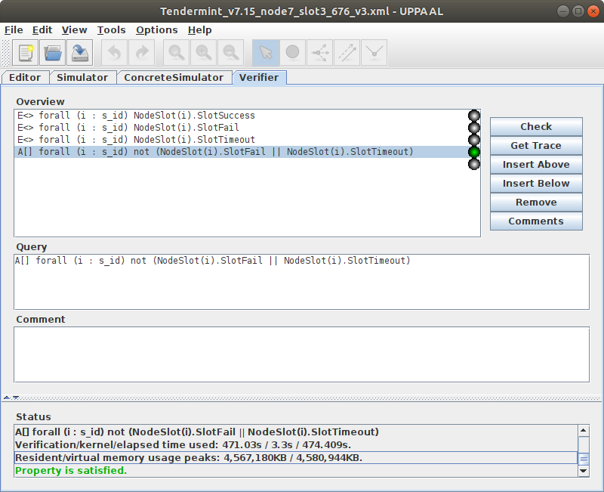
Tendermint_v7.15_node7_slot2_676_v3.xml
(Breadth first/Aggressive/CompactDataStructure option)
A[] forall (i : s_id) not (NodeSlot(i).SlotFail || NodeSlot(i).SlotTimeout)
Property is satisfied.
Verification/kernel/elapsed time used: 471.03s / 3.3s / 474.409s.
Resident/virtual memory usage peaks: 4,567,180KB / 4,580,944KB.

